Slide 1

Service Availability, Maintenance & Documentation

Slide 2
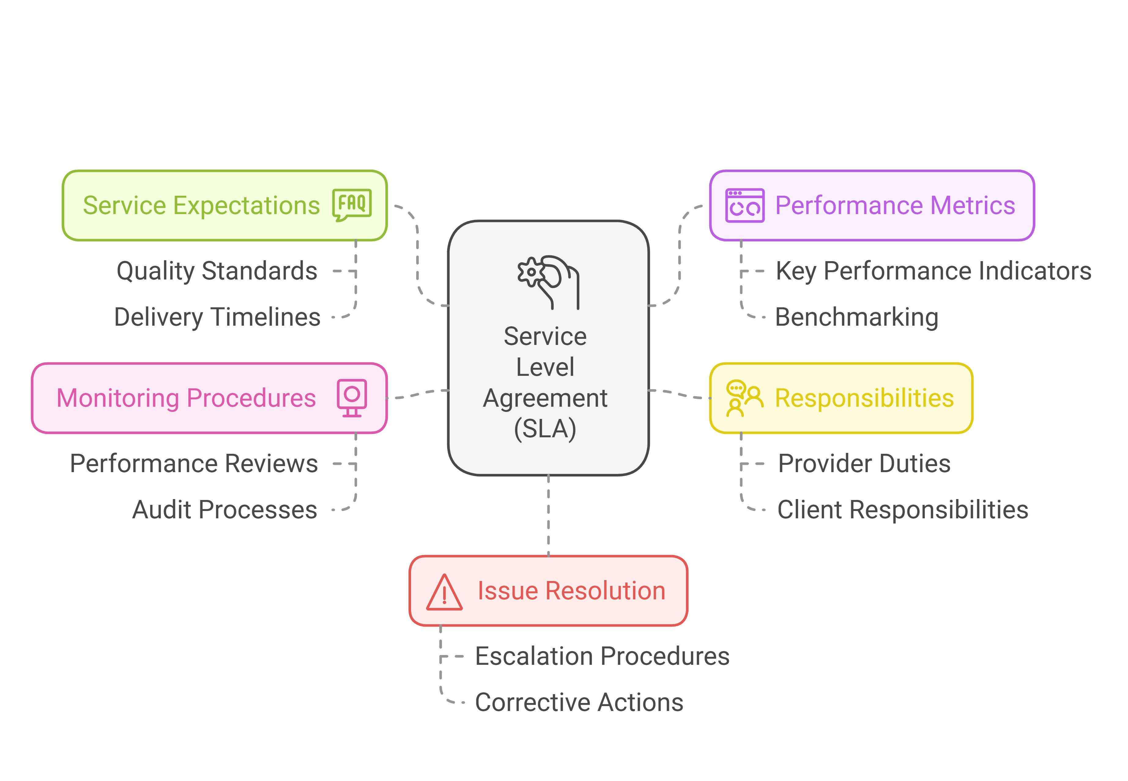

Service Level Agreement (SLA)
What is an SLA?
A formal agreement defining the expected level of service.
Establishes measurable service objectives.
Defines availability, response time, maintenance, and support commitments.
Helps manage expectations between service providers and users.

Slide 3











Key SLA Components
Service Description
Service Availability
Response Time
Resolution Time
Defines the service covered by the agreement.
Specifies the expected uptime.
Defines how quickly support begins.
Defines how quickly an issue should be resolved.
Maintenance Schedule
Roles & Responsibilities
Defines planned maintenance windows.
Defines responsibilities of providers and users.

Slide 4
SLA Metrics
SLA metrics provide measurable evidence of service quality.
Service availability / uptime
Incident response time
Resolution time
Number of service interruptions
Server performance
User satisfaction

Slide 5
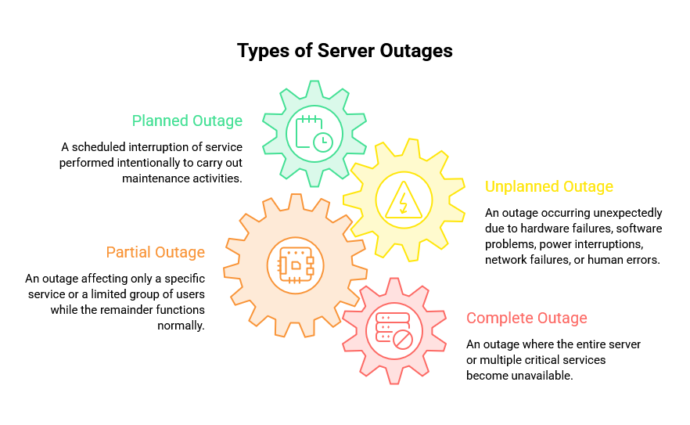
What is Outage Management?
Outage
A period when a server or service becomes unavailable or fails to perform its intended function.
Outage Management
A systematic process for detecting, assessing, restoring, verifying, and documenting service interruptions.
Goal
Minimize downtime and business disruption.

Slide 6




Types of Outages
Planned Outage
Unplanned Outage
Scheduled maintenance.
Unexpected failure.
Partial Outage
Complete Outage
Only some services or users are affected.
Entire server or critical services are unavailable.

Slide 7
Common Causes of Outages
Hardware failure
Configuration errors
Operating system or application failure
Software bugs
Network problems
Cyberattacks
Power interruption
Human error

Slide 8






Outage Management Process
Detect
Assess
Root Cause
Restore
Verify
Document
Detect the Outage
Assess the Impact
Identify the root cause
Restore the service
Verify System operation
Document & review

Slide 9
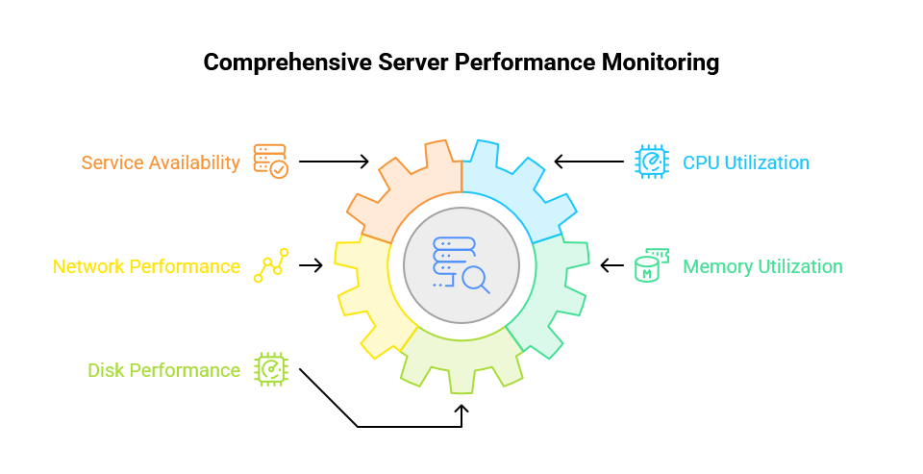
Performance Monitoring
Definition
Continuous observation and analysis of server performance.
Detect performance problems early.
Identify resource bottlenecks.
Maintain efficient server operation.
Prevent performance degradation from becoming an outage.

Slide 10









Important Performance Metrics
CPU Utilization
Memory Utilization
Disk Performance
Network Performance
Service Availability

Slide 11
Performance Monitoring Process
Identify
Configure
Collect
Analyze
Correct
Review
Critical resources
Tools and alerts
Performance data
Compare to baselines
Take corrective action
Performance trends

Slide 12
PERFORMANCE MONITORING
Baselines and Alerts
Baseline
A recorded normal level for a metric.
Alert
Automated notification when a metric crosses a threshold for a set time.
Baseline example
CPU averages 25% at 10:00 on weekdays; memory baseline before a new app deploy.
Alert example
CPU > 90% for 10 minutes → ticket or SMS; disk-space alert at 85% full.
Role: Baselines detect drift from normal; alerts trigger action before an outage.

Slide 13

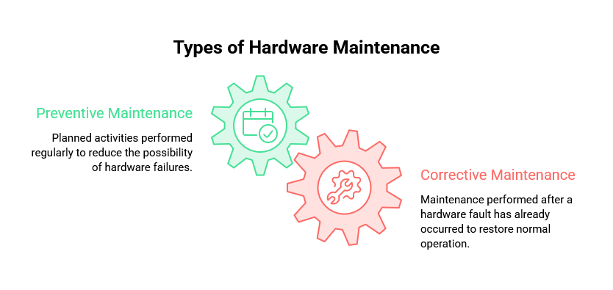
Hardware Maintenance
Definition: Preventive and corrective activities that keep server hardware reliable and operational.
Preventive Maintenance: Performed before failure. Reduces the risk of downtime.
Corrective Maintenance: Performed after failure. Repairs or replaces defective components.

Slide 14

Hardware Maintenance Activities
Physical inspection
Hardware Health Examples:
Cleaning server components
Processor temperature
Checking cooling systems
Fan speed
Inspecting power components
Power supply status
Monitoring hardware health
Memory health
Replacing faulty components
Storage condition

Slide 15






Hardware Maintenance Process
Plan
Inspect
Perform
Verify
Document
Plan the Maintenance
Inspect the Hardware
Perform Required Maintenance
Verify Sever Operations
Document the Maintance
Maintenance records include:
• Date • Components inspected/replaced • Problems identified • Actions performed • Verification results

Slide 16


Fault Tolerance
Definition
Main Principle
The ability of a system to continue operating when one or more components fail.
Failure of one component should not stop the entire service.
Approach
Uses redundancy to maintain service availability seamlessly.

Slide 17








Fault-Tolerant Components
Redundant Power Supplies
Redundant Storage
Redundant Network
Redundant Cooling
Fault-Tolerant Software

Slide 18





Fault Tolerance Process
Identify
Implement
Monitor
Detection
Replace
Identify Critical Components
Implement Redundancy
Monitor Component Health
Automatic Failure Detection
Replace the Failed Component

Slide 19








Fault Tolerance: Simple Concept
Primary component fails
Redundant takes over
Service continues

Slide 20
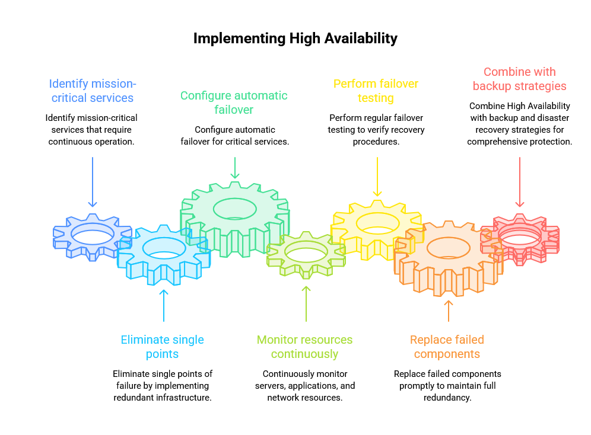
High Availability (HA)
Definition: A design approach that keeps services accessible with minimal interruption.
Goal: Keep critical services running even when failures occur.
HA Uses:
- Redundant servers
- Automatic failover
- Redundant storage & networks
- Continuous monitoring

Slide 21
High Availability Components
Redundant Server
Failover Mechanism
Redundant Storage
Redundant Network Connection
Monitoring System

Slide 22
Failover Clustering vs Load Balancing
Aspect | Failover clustering | Load balancing
What it is | Group of servers (nodes) running a service | Distributes client requests across multiple healthy servers
On failure | Another node takes over automatically | Failed nodes are removed from the pool
Main benefit | Service stays available after a node fails | No single server is overloaded; spreads risk and performance
Key point: Clustering protects against node failure; load balancing protects performance and spreads risk.

Slide 23
High Availability Process
Identify
Design
Configure
Monitor
Test
Critical Services
Redundant Infrastructure
Automatic Failover
System Health
The HA Configuration

Slide 24


Fault Tolerance vs High Availability
Fault Tolerance
High Availability
Focuses on component failure.
Focuses on overall service availability.
Uses redundant components.
Uses multiple systems and failover.
Component failure is handled within the system.
Service can move to another available system.
Key Point: High Availability can incorporate fault tolerance

Slide 25
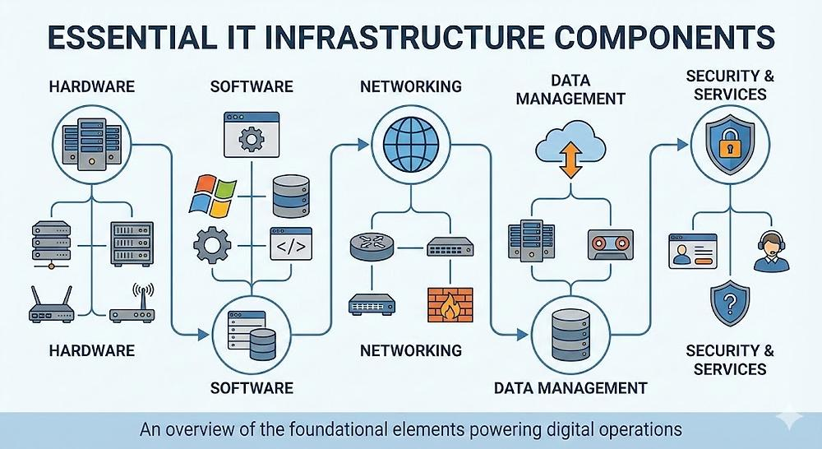
Asset Management
Definition: Systematic process of identifying, recording, monitoring, maintaining, and controlling IT assets throughout their lifecycle.
Assets Types:
- Hardware Assets
- Software Assets
- Network Assets
- Information Assets

Slide 26



Asset Information
Asset ID
Purchase date
Assigned admin/dept
Manufacturer and model
Installation date
Warranty period
Serial number
Physical location
Operational status

Slide 27
Asset Management Process
Identify
Record
Monitor
Maintenance
Retire
Identify the Asset
Record Asset Information
Monitor Asset Status
Perform Maintenance and Updates
Retire or Replace the Asset

Slide 28
Asset Lifecycle
Acquisition
Deployment
Operational Use
Maintenance
Retirement
At each stage:
Track the asset Update records Monitor condition Maintain security Plan replacement

Slide 29
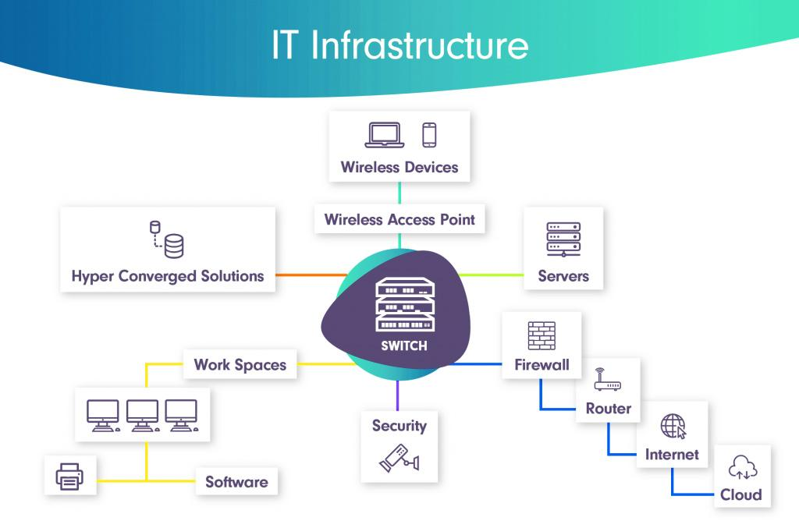
Infrastructure Documentation
Definition: The process of creating, organizing, and maintaining records about the server environment.
Helps Administrators: Install, Configure, Troubleshoot, Perform maintenance, Recover, and Plan upgrades.
Key Principle: Documentation should be maintained as a living record and updated when infrastructure changes.

Slide 30











SYSTEM ADMINISTRATION
Types of Documentation & the Process
MAJOR TYPES
Hardware
Network
Server Config
Software
Maintenance
Administrative
Servers, CPU, RAM
Storage & RAID
NICs, rack & warranty
IPs & VLANs
Switches, routers, firewalls
DNS & topology
OS & server roles
Services
Storage & security
Versions & licenses
Vendors
Updates & compatibility
Repairs & patches
Firmware updates
Replacements
SOPs
Backup / recovery
Change management
DOCUMENTATION PROCESS
Identify
Collect
Organize
Update
Review
Trainer’s Handout — Infrastructure Documentation
2

Slide 31
INFRASTRUCTURE DOCUMENTATION · TYPES
Runbooks and Infrastructure Documentation
Network diagrams
Show topology: switches, routers, firewalls, IPs and VLANs.
Configuration records
Record how each server is set up: OS, roles, services, storage.
Runbooks
Step-by-step procedures for routine and emergency tasks: failover, restore, restart a service, verify a patch.
Key point: Diagrams and records show what exists; runbooks tell administrators how to act.

Slide 32



What Should Be Documented?
Hardware specs & Network config
IP addressing & Server roles
OS versions & Storage layouts
Maintenance records & Licenses
Goal: Maintain an accurate picture of the current infrastructure.

Slide 33
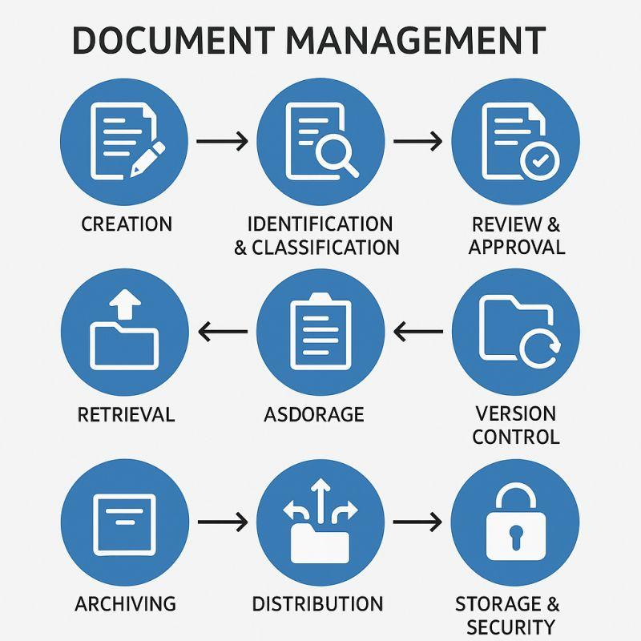
Asset Management Process
STORAGE
Identify
Collect
Organize
Maintenance
Review
Identify Information to be Documented
Collect Technical Information
Organize the Documentation
Maintain and Update Documentation
Review Documentation Regularly

Slide 34
Secure Documentation Storage
Why Protect? Infrastructure documents may contain sensitive technical information.
Methods
Store documents in controlled locations.
Restrict access to authorized personnel.
Protecting Confidential Information
Keep appropriate backup copies and protect them during failures.
Monitor Documentation Access
Key Principle: Documentation must be available when needed but protected from unauthorized access.

Slide 35






SYSTEM ADMINISTRATION · SECURITY
Importance, Best Practices & Example
Importance
Best Practices
Protects valuable organizational technical knowledge
Supports business continuity and disaster recovery
Reduces information leakage and unauthorized disclosure
Improves security and supports compliance requirements
Ensures admins can quickly access info during emergencies
Use centralized and secure repositories
Apply minimum necessary access permissions
Update documentation after infrastructure changes
Back up documentation regularly
Monitor access and investigate unusual activity
Review permissions and security controls periodically
Keep documentation available to authorized recovery teams
EXAMPLE
A financial organization stores network diagrams, firewall configurations, server inventories, backup procedures, and disaster recovery plans in a centralized repository.
Access limited to authorized administrators
Changes recorded with user and timestamp
Automatic nightly backups protect against loss
Fast document retrieval during server failure
Trainer’s Handout — Secure Documentation Storage
3

Slide 36
Process of Secure Documentation Storage
Identify
Classify
Access Control
Backup
Review
Identify Sensitive Documentation
Classify and Organize Documentation
Apply Appropriate Access Controls
Protect and Back Up Documentation
Review and Maintain Documentation Security

Slide 37
Lifecycle Planning: Putting It Together
Performance monitoring
Shows capacity and failure trends; signals the need for an upgrade.
Asset management
Tracks age, warranty, location and status; supports replacement planning.
Hardware maintenance
Extends life and records failures; shows which assets to retire.
Evidence from all three
Decision
Refresh or Expand or Decommission
Key point: Lifecycle decisions are made on evidence, not guesswork.

Slide 38


Relationship Between All Topics
SLA: Defines service expectations.
High Availability: Maintains service availability.
Performance Monitoring: Detects performance problems.
Outage Management: Restores services after incidents.
Hardware Maintenance: Prevents hardware failures.
Asset & Infrastructure Documentation: Provides accurate operational information.
Fault Tolerance: Handles component failures.

